Slide 1
Cash Collection Spokes
ICICI Bank Appathon
April 18th, 2017

Slide 2
Contents
01 | Problem Statement
02 | Solution Overview
03 | User Stories
04 | Solution Flows
05 | Plan

Slide 3
Target Segment
Cash / cheque collection is a challenge, currently we are looking at retail / corporate customers of the Bank
Current scope is to collect cash/Cheque, Future collection can expand to other instruments / documents etc
Can be easily expanded to other Financial services / Insurance
Ecosystem covers
Customer –could be retail or corporate who would love their Bank to provide mobile cash collection services
Bank – can provide, safe, secure and convenient way to provide mobile cash collection services
Service Provider/Agent – On behalf of Banks will collect in a safe and secure manner

Slide 4
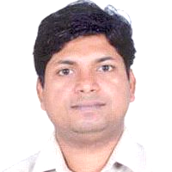



Rupik - Meet the Team
Vijay Nair
Banking and Financial Services Solution Architect
18 +years of diverse experience into Banking and Financial Services, Technology. He will provide Strategic Leadership and help oversee the program. He has led several strategic initiatives for our Global Fortune 100 customers.
Amitsingh Rajput
Solution Evangelist and Development
14+ years of experience with web and software development and Management. Significant experience in solution consulting and implementation. Expert in C#, .NET, and T-SQL with database analysis and design. Solid knowledge in SQL Server RDBMS and developmental tools. Proficient in Dot Net Framework, Asp.Net, C#, Classic Asp, VB and Oracle database
Ajit Nair
Alliances and Partnerships
18+ years of experience within the business and IT organization. Strategic Alliance and Partnerships experience for over 5+ years. Hands on experience as a software professional with in-depth understanding of Software Development Life Cycle.
Kiran Bhangare
Banking and Insurance Services Presales Architect
15 +years of extensive presales and solutioning knowledge for Insurance, Banking and Financial services industry. Experience with a broad range of presales process and technology areas from application / infrastructure through to development both in-house and outsourced via off-shore and near shore

Slide 5
Problem Statement
Business Need
Rupic Value Proposition
Faster Time to Market with reduced customer and service provider (collection agent) onboarding
Flexible and faster way for cash collection – Banks, Collection Agents, Retail and Corporate customers
Improved productivity and accuracy through Rupic’s cash collection module
Convenient, safe and secure solution – Doorstep collection, 2FA authentication mechanism, data security
Faster Customer / Collection Agent Onboarding
Higher Accuracy and Efficiency
Improved Customer Service: Retail, Agents and Corporate
Audit Trail and Reconciliation
“Flexible, Secure and Faster Cash Collection through Rupic”

Slide 6






Solution Overview
Service Management
Authentication
System Admin
OnBoarding
Reporting
Register
Schedule
Select
Collect

Slide 7
Solution Overview:: What Next
1
On Demand - request for cash / cheque collection anytime / anywhere
Collection as a Service - CaaS
Automatic allocation of collection agent using location based APIs, GPS
2
Rupic can be extended to collect any other instruments like loan collection, insurance premiums, corporate documents amongst others
3
On Premises capture of Bank cheque details: Smart photo
4
RFID / Barcode based package tracking
“Future is Digital through Rupic”

Slide 8
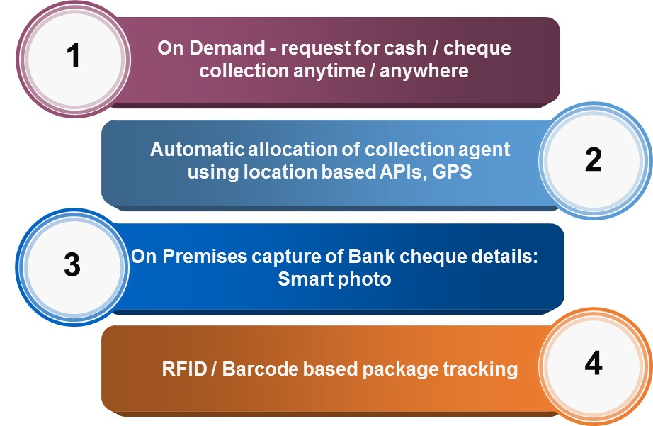
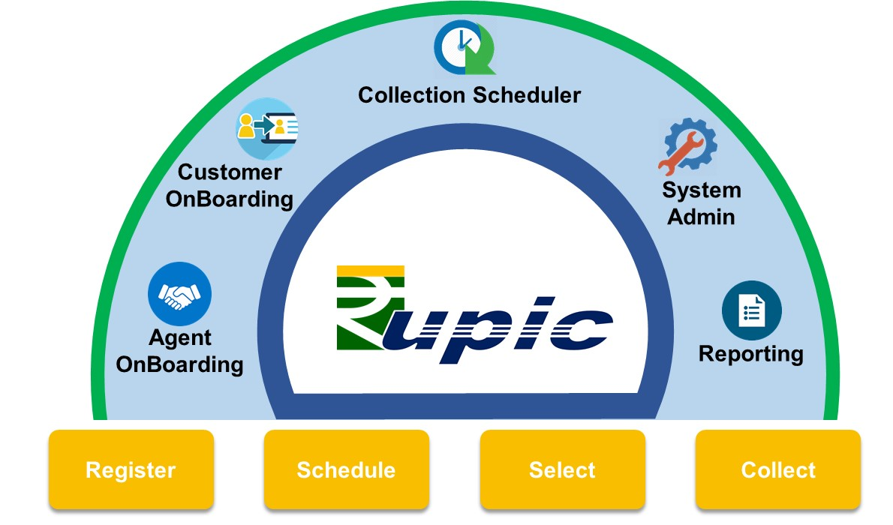
Solution:: Overview and Future Scope
What Next
Solution Overview
Collection as a Service - CaaS
Rupic can be extended to collect any other instruments like loan collection, insurance premiums, corporate documents amongst others

Slide 9
User Stories
Retail Customers
Bank
Corporate Customers
Customer enrolls using his/her Ac/No in the system
The system generates unique PIN for the customer
Customer logs in to the system using this unique PIN
System gives details of his Account/Balance etc and allows the customer to request for cash/cheque pickup
Customer can either schedule a regular (Daily/Weekly) Cash/Cheque pickup or It can be event driven (As per requirement)
Customer provides his cash pickup details (Cash / Cheque details, and the location) and a Pickup ID is generated and date/time of pickup is confirmed
Bank/Branch and its associated SP/Agency is notified on the system about the new PickupID
Pickup is scheduled automatically as per the nearest branch and its associated Service Provider (SP)/Agency
Customer gets a confirmation about the Agency that will pickup Cash/Cheque from the customer location
Once the cash/cheque is submitted to the Bank Branch, the branch SPC verifies the collection
Once verified, the cash/cheque is then deposited into the respected Bank Account
The system sends the receipt message to the customer and consolidated daily report is shared to the Bank and SP
Customer can look at the historic records to view all his pickups
Bank is provided with SP wise collection details
Corporate user will have login for their Head office (Admin user) and their regional point of contact (Normal user)
Admin can enroll for the cash pick up facility using their company details
Admin user will share all the locations for conducting feasibility
The system will autoallocate the regional offices to the service provider based on the branch they operate regionally. We can look at Latitude/Longitude or Pincode of the location
Rest of the data flow will be similar to the retail cash pickup
Once allocated, the user can then schedule the cash pickup
Bank and the customer gets daily report

Slide 10

Flow Diagram
Retail
Specify details
Time/D/W and Place
N
A
N
Customer
Onetime
Y
Customer is enrolled (Onetime)
Cash Details
Specify Place
Y
System generates PIN
Cash/
Cheque
Y
User Logs in using PIN
Cheque Details
B
C
N
Bank system
User can view balance

Slide 11
Flow Diagram
Corporate customer Enrolls
Corporate customer Logs In
A
Shares Locations of offices
Offices/Location/Agency match
SP Agency offices allocated for each location
B

Slide 12
Flow Diagram
C
Agency submits the cheque/cash at Bank Branch
Pickup confirmed, ID Generated
Agency verifies the cash/cheque collected
Bank is intimated
Pickup Worklist added
SP Superuser Login
Agent picksup cash and confirms on the system
D
Allocate SP Agent
Task List assigned
At customer location shares PIN (Unique)
Customer enters the the unique PIN (OTP)
Customer gets pickup receipt
SP Agent login

Slide 13
Flow Diagram
Bank Branch Office Logs In
D
SP submits Cash/
Cheque
Service Provider wise Pickups
Status of Pickups
Y
Verify the cash/cheque
Cash/Cheque Deposited
Customer gets confirmation
Daily reports

Slide 14
Plan: Timelines and Future Scope – Estimated
Including APIs and Integrating solution with existing bank systems and applications
Testing and application documentation
Future Scope
On Demand - request for cash / cheque collection anytime / anywhere
Automatic allocation of collection agent using location based APIs, GPS
On Premises capture of Bank cheque details: Smart photo
RFID / Barcode based package tracking
Complete application development for retail and corporate customers
Testing & Documentation
API (fication) and Integration
Retail / Corp
3 Months
1 month
1 month
5 months Implementation Time
Development to Implementation cycle time of 5 months for –
Agent and customer onboarding
Service Management
Reporting
System Admin

Slide 15

Thank You!

